Slide 1
QT - QML
Introduction

Slide 2
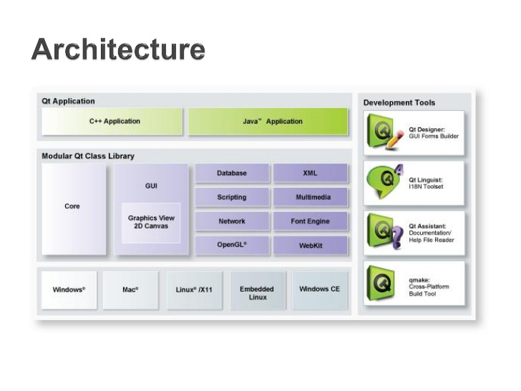
QT is a FRAME WORK FOR DEVELOPING C/C+, Java APPLICATION
IDE: QT CREATOR
SDK (LIBRARY): QT 5.9
DOWNLOAD: https://www.qt.io/download-qt-for-application-development
Intuitive APIs for C++ and JavaScript-like programming with Qt Quick for rapid UI creation

Slide 3
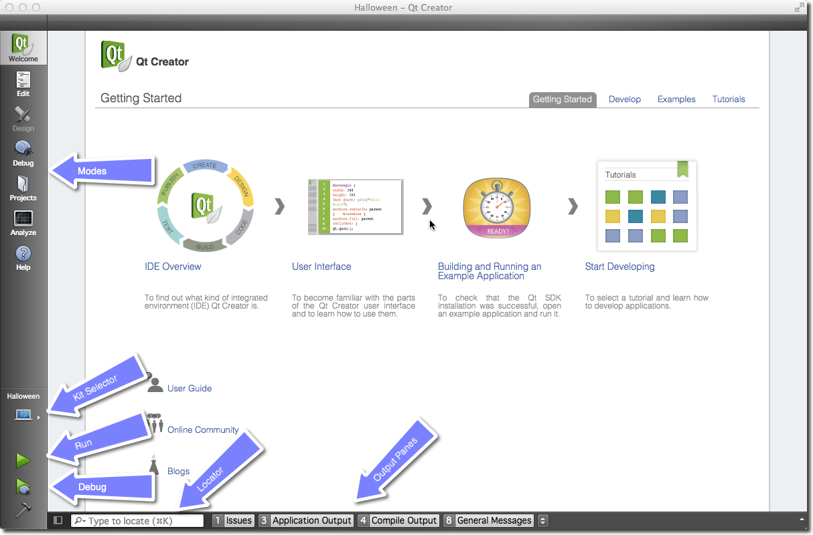
QT-Creator
Main Interface
IDE for developing application
- Welcome mode: For your orientation.
- Edit mode: Focus on the code
- Design mode: Focus on the UI design
- Debug mode: Retrieve information about a running application
- Projects mode: Modify your projects run and build configuration
- Analyze mode: For detecting memory leaks and profiling
- Help mode: Access to the Qt documentation

Slide 4
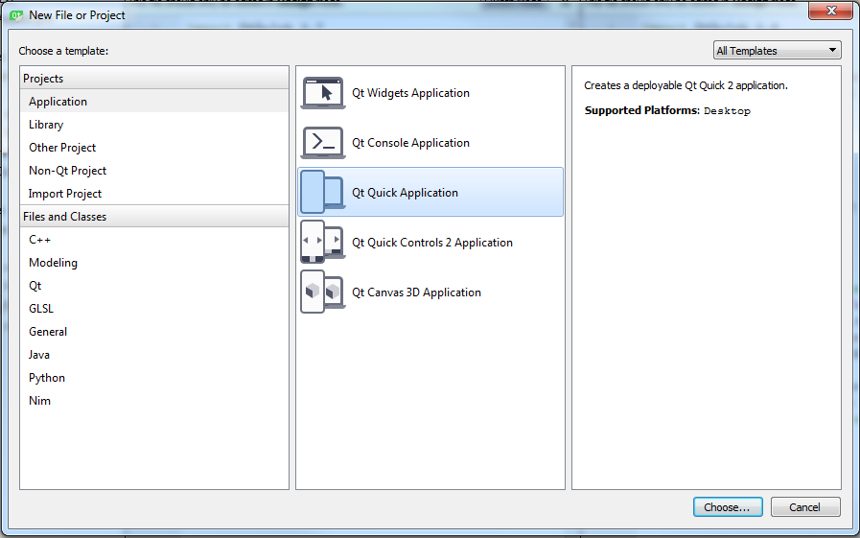
QT-CREATOR
Create a new project by using File ‣ New File or Project
Focus on:
Application > Qt Quick Application
Application > Qt Quick 2 Control Application
Library
Manage Project
http://doc.qt.io/qtcreator/quick-projects.html

Slide 5
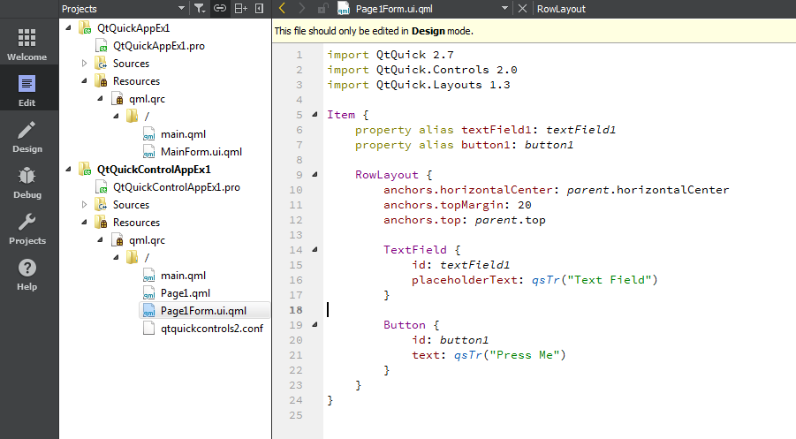
QT PROJECT
Structure

Slide 6
QT STUDY
Signal/Slot
QObject
QThread
QT Container (QMap, QList, QVector, QHash, QStringList) (Refer Container Classes in Help)
QVariant
QDebug (logging to console)

Slide 7
QML APPLICATION
QtQml
Qt Quick
The standard library of types and functionality for QML
(visual types, interactive types, animations, models and views, particle effects and shader effects)
QML is a user interface specification and programming language
(a declarative language that allows user interfaces to be described in terms of their visual components and how they interact and relate with one another)
QML

Slide 8
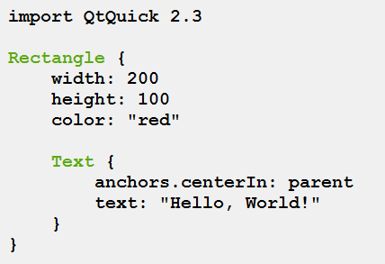
QML Application
A QML document defines a hierarchy of objects.
Every QML document consists of two parts:
Imports section
Object declaration section
QML Document structure
(Refer to The QML Reference in Help)

Slide 9
QML APplication
Separate the computing intensive and native operation of your application from the UI part
UI (qml)
QML Module
Bussiness (C/C++)

Slide 10
QML Language
QML is a hierarchy of elements
Every QML file needs to have exactly one root element, like HTML
An element is declared by its type followed by {}
Elements can have properties, they are in the form name : value
Arbitrary elements inside a QML document can be accessed by using their id
Elements can be nested, meaning a parent element can have child elements. The parent element can be accessed using the parent keyword

Slide 11
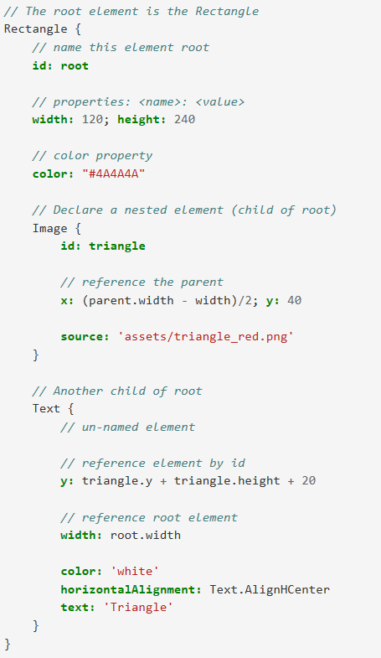
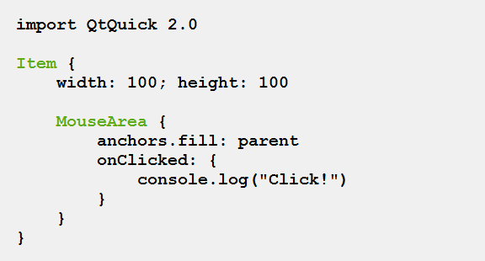
QML Example
The set of QML object-type attribute types is as follows:
The id attribute
Property attributes
Signal attributes
Signal handler attributes
Method attributes
Attached properties
(Refer to The QML Reference in Help)

Slide 12
Exercise
Hello World App
Search Component

